Slide 1


IBM DATA SCIENCE
APPLIED DATA SCIENCE CAPSTONE PROJECT
Space X to Space Y
AUTHOR
SHUBHAM MEHAR
DATE- 22/01/2024

Slide 2

REPORT OUTLINE
Executive Summary | 3-4
Introduction | 5-6
Methodology | 7
Data Collection | 8-11
Data Wrangling | 12-13
Feature Engineering | 14
Interactive Map with Folium | 15
Interactive Map with Plotly and Dash | 16
Predictive Analysis | 17
Results | 18
EDA using Visualization | 19-25
Interactive Analysis with Folium | 26-30
Interactive Analysis with Dash and Plotly | 31-37
EDA using SQL | 38-44
Predictive Analysis | 45-48
Conclusion | 49
Project Files link (GitHub) | 50
GitHub Repository Link

Slide 3
EXECUTIVE SUMMARY
SUMMARY OF METHADOLOGIES
Data Collection involves using the SpaceX REST API and web scraping techniques.
Data Wrangling is implemented to create a success/failure outcome variable.
Exploratory Data Analysis considers payload, launch site, flight number, and yearly trends using data visualization techniques.
Data is analyzed with SQL, calculating statistics like total payload, payload range for successful launches, and the total number of successful and failed outcomes.
Launch site success rates and proximity are explored using Folium.
Launch sites with the most success and successful payload ranges are visualized using Plotly and Dash to create an interactive dashboard.
Model Building utilizes logistic regression, support vector machine (SVM), decision tree, and K-nearest neighbor (KNN) to predict landing outcomes.

Slide 4
EXECUTIVE SUMMARY
SUMMARY OF RESULTS
Success rates improve as flight numbers increase from launch sites, with an initially poor rate.
Higher payload correlates with a higher success rate.
CCAFS SLC 40 launches most payloads weighing over 12000 kg.
VAFB-SLC has no launches for heavy payloads (>10000 kg).
ES-L1, GEO, HEO, and SSO show a perfect 100% success rate.
SO exhibits a 0% success rate. GTO, ISS, LEO, MEO, and PO have success rates between 50% and 80%.
Decision Tree algorithm emerges as the best predictor, showcasing superior accuracy on validation data among various algorithms.

Slide 5
INTRODUCTION
PROJECT BACKGROUND
The commercial space age is here, companies are making space travel affordable for everyone. Virgin Galactic is providing suborbital spaceflights. Rocket Lab is a small satellite provider. Blue Origin manufactures sub-orbital and orbital reusable rockets. Perhaps the most successful is SpaceX.
SpaceX’s accomplishments include:
Sending spacecraft to the International Space Station. Starlink, a satellite internet constellation providing satellite Internet access. Sending manned missions to Space. One reason SpaceX can do this is the rocket launches are relatively inexpensive. SpaceX advertises Falcon 9 rocket launches on its website with a cost of 62 million dollars; other providers cost upwards of 165 million dollars each, much of the savings is because SpaceX can reuse the first stage.
TO FIND
In this capstone, you will take the role of a data scientist working for a new rocket company. Space Y that would like to compete with SpaceX founded by Billionaire industrialist Allon Musk. Your job is to determine the price of each launch.

Slide 6
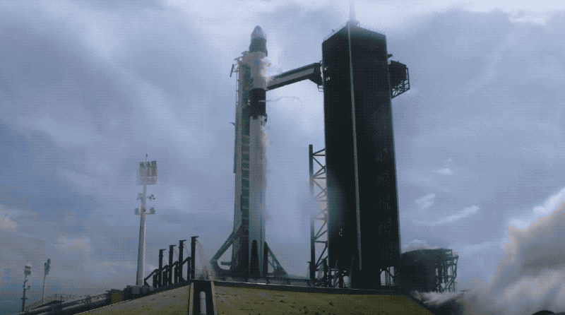


SPACE X
Successfully Launch
Successfully Landed
Unsuccessfully Landed

Slide 7
METHODOLOGY
EXECUTIVE SUMMARY
DATA COLLECTION METHODOLOGY
Collecting data with an API
Web Scrapping -using the Python BeautifulSoup package to web scrape some HTML tables that contain valuable Falcon 9 launch records from WikiPiedia.
Data Wrangling- Filtering data for Falcon 9 Launches, handling missing data and Feature Encoding.
Exploratory data analysis (EDA) using visualization libraries Matplotlib and Seaborn and SQL.
Interactive visual analytics using Folium and Plotly Dash.
Predictive analysis using classification models
Train Test Split
Train the chosen model on the training dataset.
Adjust hyperparameters to optimize performance.
Evaluate the model's performance on the testing dataset using appropriate metrics

Slide 8
DATA COLLECTION
Collecting the Data with an API
SpaceX launch data that is gathered from an API, specifically the SpaceX REST API. This API will give us data about launches, including information about the rocket used, payload delivered, launch specifications, landing specifications, and landing outcome.
Request and parse the SpaceX launch data using the GET request.
The response content as a Json using .json() and turn it into a Pandas dataframe using .json_normalize().
Create dataframe from the dictionary
Filter dataframe to contain only Falcon 9 launches
Replace missing values of Payload Mass with calculated .mean()
Export data to csv file
Data collection from API file link

Slide 9
DATA COLLECTION
Collecting the Data with an API Flowchart
Request SpaceX Launch Data
Parse API Response as JSON
Create DataFrame using .json_normalize()
Filter Falcon 9 Launches
Replace Missing Payload Mass
Export to CSV

Slide 10
DATA COLLECTION
Web scraping
Using the Python BeautifulSoup package to web scrape some HTML tables that contain valuable Falcon 9 launch records from Wiki Pages.
Request the Falcon9 Launch Wiki page from its URL
Create a BeautifulSoup object from the HTML response.
Extract all column/variable names from the HTML table header
Create a data frame by parsing the launch HTML tables
Fill in the parsed launch record values into launch_dict
Export it to a CSV
Web Scrapping file link

Slide 11
DATA COLLECTION
Web scraping Flowchart
Import the necessary libraries
Send a GET request to Falcon 9 Launch Wiki URL
Create a BeautifulSoup object from HTML response
Extract all column/variable names from the HTML table header
Create an empty dictionary (launch_dict)
Parse the launch HTML tables and fill in launch_dict
Create a Pandas DataFrame from launch_dict
Export the DataFrame to a CSV file

Slide 12
DATA WRANGLING
Exploratory Data Analysis (EDA) to find some patterns in the data and determine what would be the label for training supervised models.
Calculate the number of launches on each site
Calculate the number and occurrence of each orbit
Calculate the number and occurence of mission outcome of the orbits
Create a landing outcome label from Outcome column
Using the Outcome, create a list where the element is zero if the corresponding row in Outcome is in the set bad_outcome; otherwise, it's one. Then assign it to the variable landing_class:
Export it to a CSV
Data Wrangling File Link

Slide 13
DATA WRANGLING
Exploratory Data Analysis Using SQL
Display the names of the unique launch sites in the space mission
Display 5 records where launch sites begin with the string 'CCA'
Display the total payload mass carried by boosters launched by NASA (CRS)
Display average payload mass carried by booster version F9 v1.1
List the date when the first succesful landing outcome in ground pad was acheived.
List the names of the boosters which have success in drone ship and have payload mass greater than 4000 but less than 6000
List the total number of successful and failure mission outcomes
List the names of the booster_versions which have carried the maximum payload mass. Use a subquery
List the records which will display the month names, failure landing_outcomes in drone ship ,booster versions, launch_site for the months in year 2015.
Rank the count of landing outcomes (such as Failure (drone ship) or Success (ground pad)) between the date 2010-06-04 and 2017-03-20, in descending order.
SQL FILE LINK

Slide 14
DATA WRANGLING
Exploratory Data Analysis Using Visualization
Matplotlib and Seaborn python libraries are used for EDA using Visualizations.
Visualize the relationship between Flight Number and Launch Site
Plot a scatter point chart with x axis to be Flight Number and y axis to be the launch site, and hue to be the class value
Visualize the relationship between Payload and Launch Site
Plot a scatter point chart with x axis to be Pay Load Mass (kg) and y axis to be the launch site, and hue to be the class value
Visualize the relationship between success rate of each orbit type
check if there are any relationship between success rate and orbit type, use groupby method on Orbit column and get the mean of Class column.
Visualize the relationship between FlightNumber and Orbit type
Plot a scatter point chart with x axis to be FlightNumber and y axis to be the Orbit, and hue to be the class value
Visualize the relationship between Payload and Orbit type
Plot a scatter point chart with x axis to be Payload and y axis to be the Orbit, and hue to be the class value
Visualize the launch success yearly trend
Plot a line chart with x axis to be the extracted year and y axis to be the success rate
EDA Visualization File Link

Slide 15
FEATURE ENGINEERING
some preliminary insights about how each important variable would affect the success rate, we will select the features that will be used in success prediction in the future module.
Create dummy variables to categorical columns
Use the function get_dummies and features dataframe to apply OneHotEncoder to the column Orbits, LaunchSite, LandingPad, and Serial. Assign the value to the variable features_one_hot, display the results using the method head. Your result dataframe must include all features including the encoded ones.
Cast all numeric columns to `float64`
features_one_hot dataframe only contains numbers cast the entire dataframe to variable type float64, use astype function
Export it to a CSV

Slide 16
Interactive Map with Folium
Mark all launch sites on a map
Using the launch site name, coordinates (i.e., latitude and longitude) to mark all launch sites on an interactive map. Add a circle marker on the launch site with the launch site name using an icon label.
Mark the success/failed launches for each site on the map
To enhance the map by adding the launch outcomes for each site, and see which sites have high success rates. Recall that data frame spacex_df has detailed launch records, and the class column indicates if this launch was successful or not
create markers for all launch records. If a launch was successful (class=1), then we use a green marker and if a launch was failed, we use a red marker (class=0)
Marker clusters can be a good way to simplify a map containing many markers having the same coordinate.
Create a new column in launch_sites dataframe called marker_color to store the marker colors based on the class value
Calculate the distances between a launch site to its proximities
MousePosition on the map to get coordinate for a mouse over a point on the map. As such, while you are exploring the map, you can easily find the coordinates of any points of interests (such as railway)
Launch site and explore its proximity to see if you can easily find any railway, highway, coastline, etc. Move your mouse to these points and mark down their coordinates (shown on the top-left) in order to the distance to the launch site.
Interactive Map with Folium File Link

Slide 17
Interactive Dashboard with Plotly Dash
Building a Plotly Dash application for users to perform interactive visual analytics on SpaceX launch data in real-time.
This dashboard application contains input components such as a dropdown list and a range slider to interact with a pie chart and a scatter point chart.
Add a Launch Site Drop-down Input Component
To select launch site from drop down
Add a callback function to render success-pie-chart based on selected site dropdown
It will help to visualize the pie chart for all launch site or for particular launch site.
Add a Range Slider to Select Payload
Slider is used to check payload between a range.
Add a callback function to render the success-payload-scatter-chart scatter plot
It will change according to slider range and dropdown selected launch site.
Interactive Dashboard with plotly dash file link

Slide 18
Predictive Analysis
Create a NumPy array from the column Class in data
Standardize the data in X then reassign it to the variable X using the transform
train_test_split to split the data X and Y into training and test data. Set the parameter test_size to 0.2 and random_state to 2.
Create a GridSearchCV object for classification algorithm
The GridSearchCV object for classification algorithms. We display the best parameters using the data attribute best_params_ and the accuracy on the validation data using the data attribute best_score_.
Calculate cc is a table that is often used to evaluate the performance of a classification algorithm. It summarizes the results of a classification problem, showing the number of true positive (TP), true negative (TN), false positive (FP), and false negative (FN) predictions.
Predictive analysis (Machine Learning) File Link

Slide 19
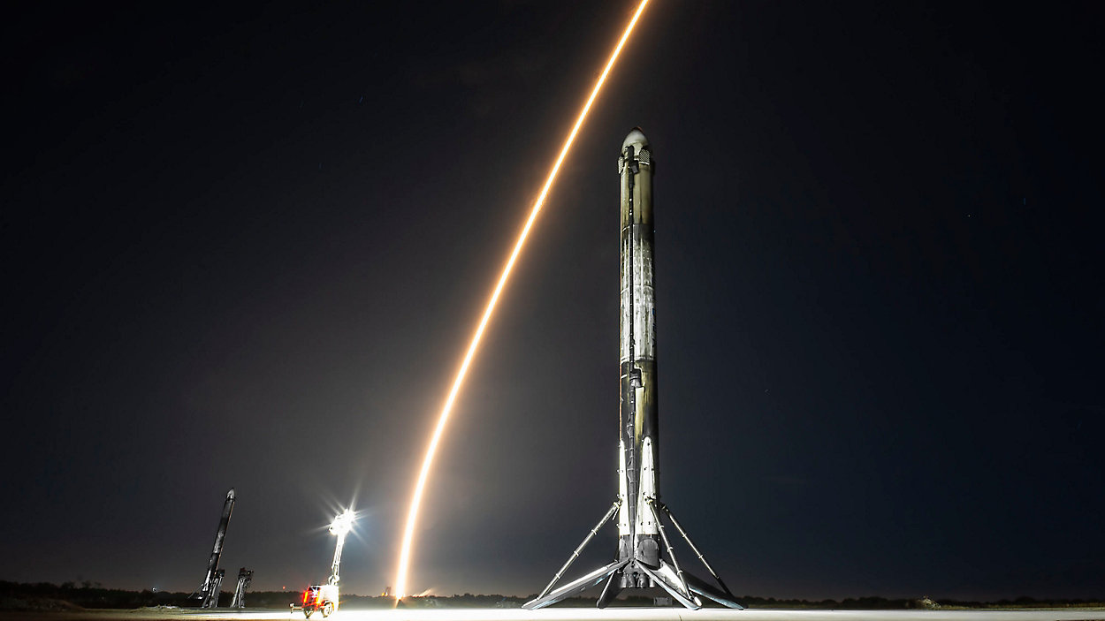
RESULTS
Exploratory data analysis results
Interactive analytics demo in screenshots
Predictive analysis results

Slide 20

Exploratory Data Analysis
Using Visualization

Slide 21
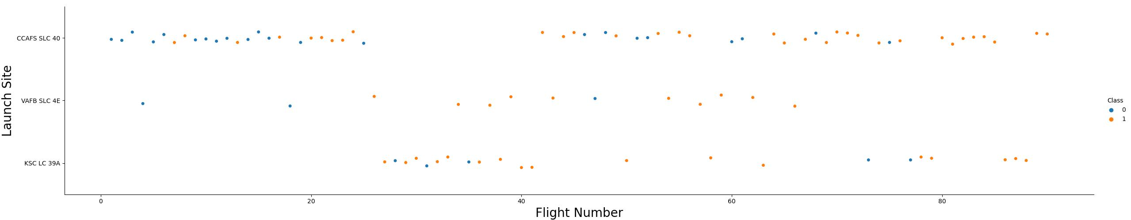
The relationship between Flight Number and Launch Site
Class | Landing Result | Color Code
0 | Fail | Blue
1 | Success | Orange
As the flight number increases from the launch sites, the success rate also improves. Initially, the success rate is poor.

Slide 22
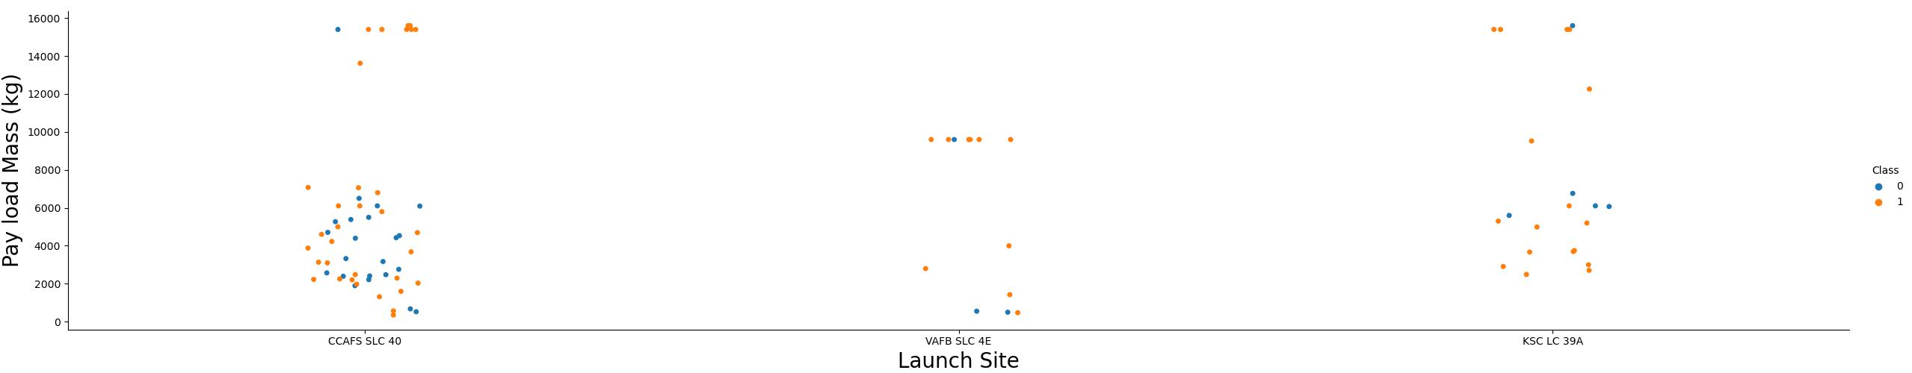
The relationship between Payload and Launch Site
The higher the payload, the higher the success rate.
Most payloads weighing more than 12000 kg are launched from CCAFS SLC 40 launch site.
VAFB-SLC launch site there are no rockets launched for heavy payload mass(greater than 10000).

Slide 23
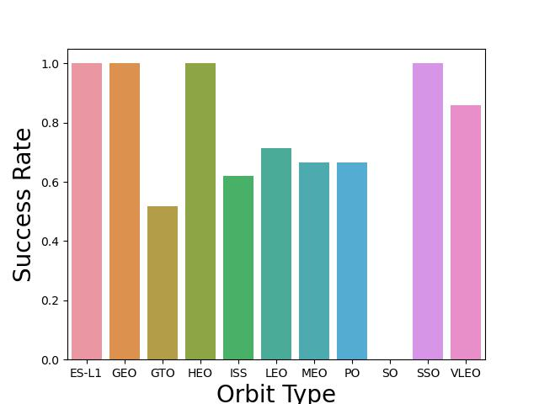
The relationship between success rate of each orbit type
ES-L1, GEO, HEO, and SSO have a 100% success rate.
SO has a 0% success rate.
GTO, ISS, LEO, MEO, and PO have success rates between 50% and 80%.

Slide 24
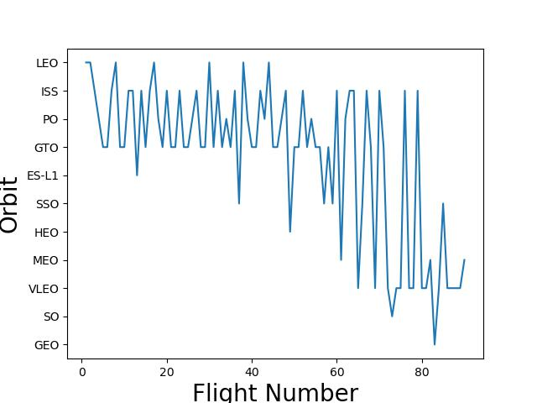
The relationship between FlightNumber and Orbit type
The LEO orbit the Success appears related to the number of flights; on the other hand, there seems to be no relationship between flight number when in GTO orbit.

Slide 25
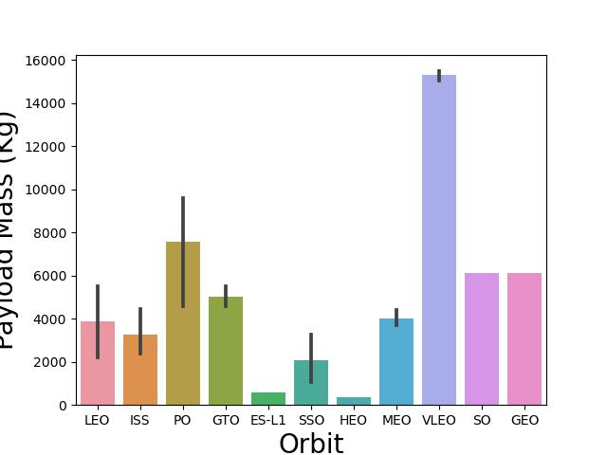
The relationship between Payload and Orbit type
With heavy payloads the successful landing or positive landing rate are more for Polar,LEO and ISS.
However for GTO we cannot distinguish this well as both positive landing rate and negative landing(unsuccessful mission) are both there here.

Slide 26
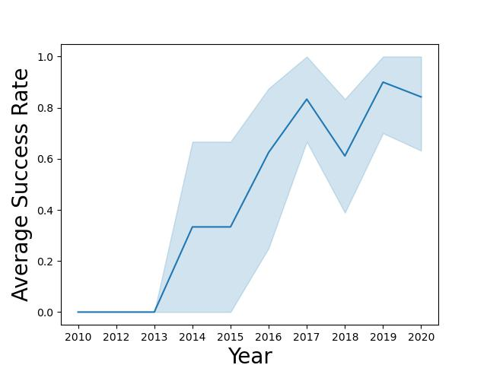
The launch success yearly trend
The success rate since 2013 kept increasing till 2017 (stable in 2014) and after 2015 it started increasing.

Slide 27
Interactive Visual Analytics
with Folium

Slide 28
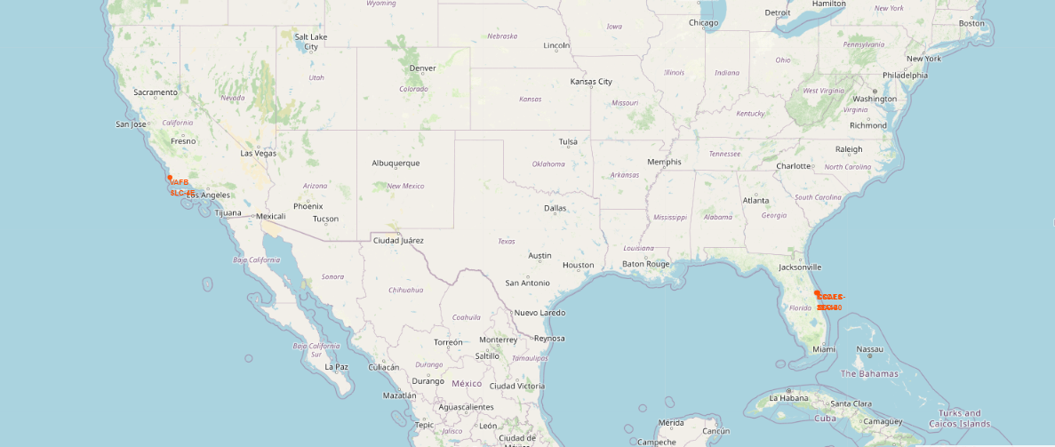
All launch sites on a map
KSC LC-39A
CCAFS SLC 40
CCAFS LC 40
VAB SLC 4E
Q. Are all launch sites in proximity to the Equator line?
Ans- Yes, Space launch sites are situated near the equator to leverage the Earth's higher rotational velocity, reducing the energy required for launches. This efficiency allows rockets to carry heavier payloads and reach various orbital inclinations. Proximity to the equator also offers safety benefits by directing launch debris over open ocean areas.
Q. Are all launch sites in very close proximity to the coast?
Ans- Yes, Space launch sites near coasts provide clear, unpopulated paths over the ocean, minimizing risks in case of launch failures. Coastal locations aid logistical efficiency by allowing transport of rockets and components by sea.

Slide 29
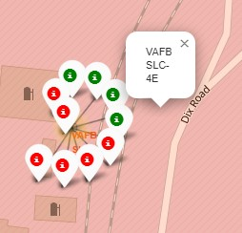
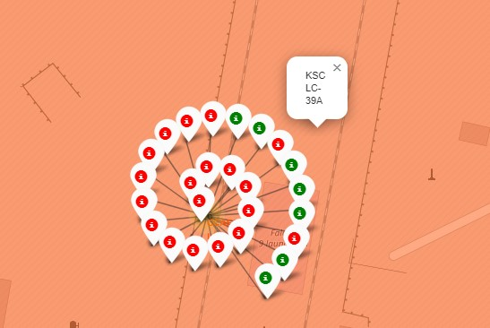
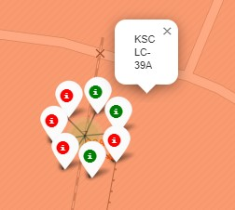
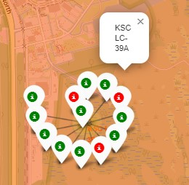
Mark the success/failed launches for each site on the map
VAFB SLC-40
CCAFS LC 40
CCAFS SLC 40
KSC LC-39A
Note-
The red marker failed launches and Green markers are Successful launches.
Because of overlapping marker circles the marker may show wrong launch site name.

Slide 30
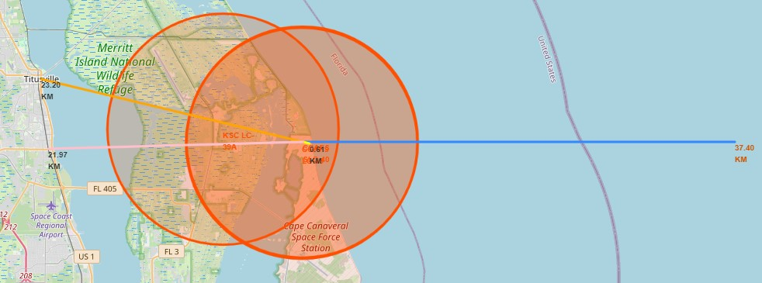
The distances between a launch site to its proximities
CCAFS SLC – 40 Launch Site to | Colour Line | Distance from Launch Site
Sea Cost | Blue Line | 0.86Km
Highway | Yellow Line | 0.61Km
City | Orange Line | 23.20Km
Railway Route | Pink Line | 21.97 Km

Slide 31
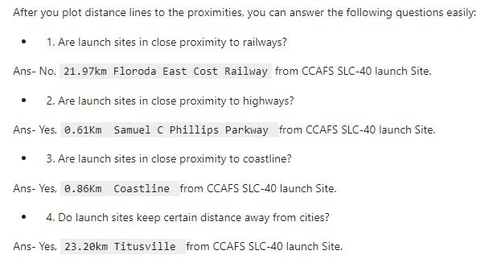
The distances between a launch site to its proximities

Slide 32
Interactive Dashboard with
Plotly and Dash

Slide 33
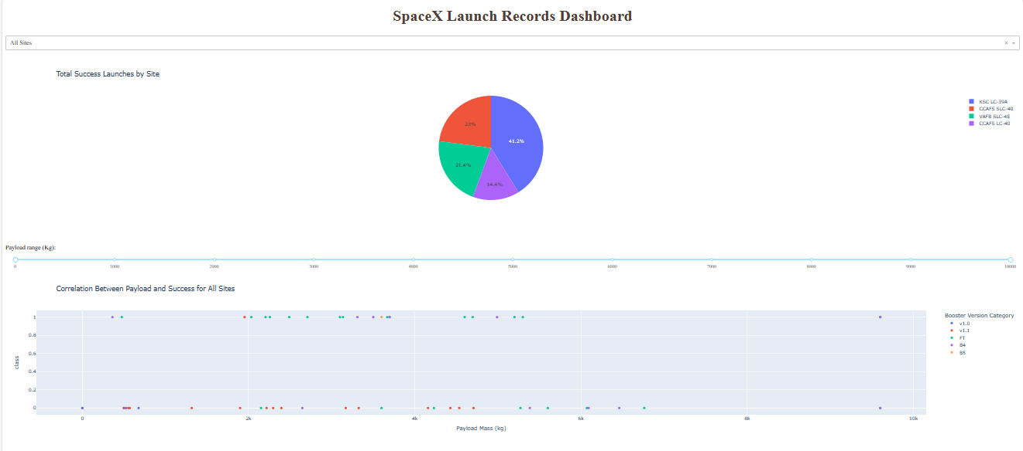
SpaceX Launch Records Dashboard

Slide 34
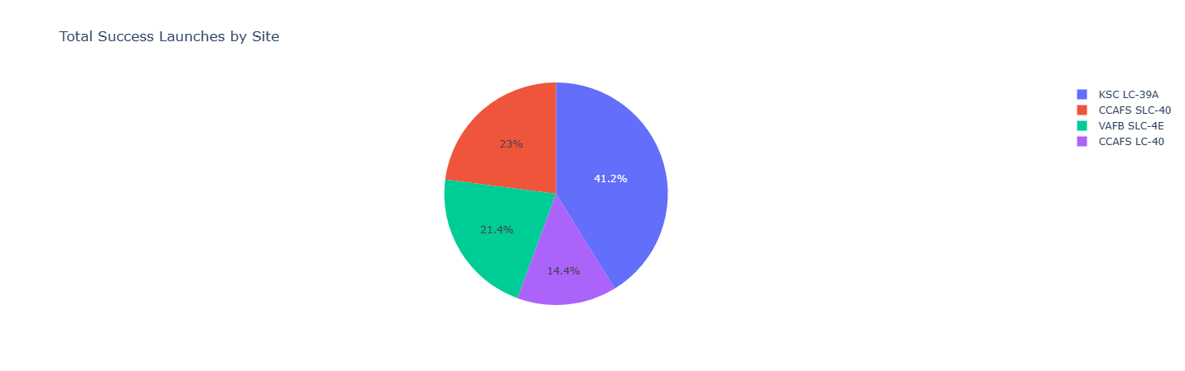
The largest successful launches
Q. Which site has the largest successful launches?
Ans- KSC LC-39A

Slide 35
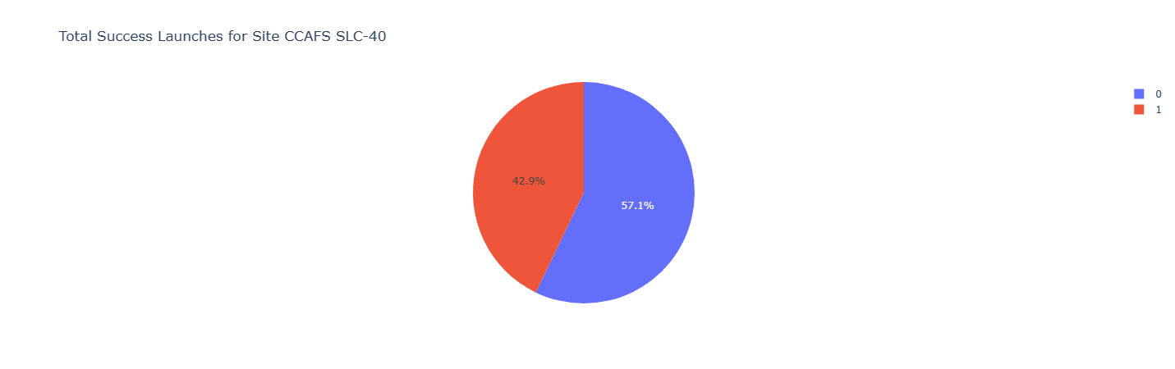
The highest launch success rate
Q. Which site has the highest launch success rate?
Ans- CCAFS SLC-40 has the highest launch success rate 42.9%.

Slide 36
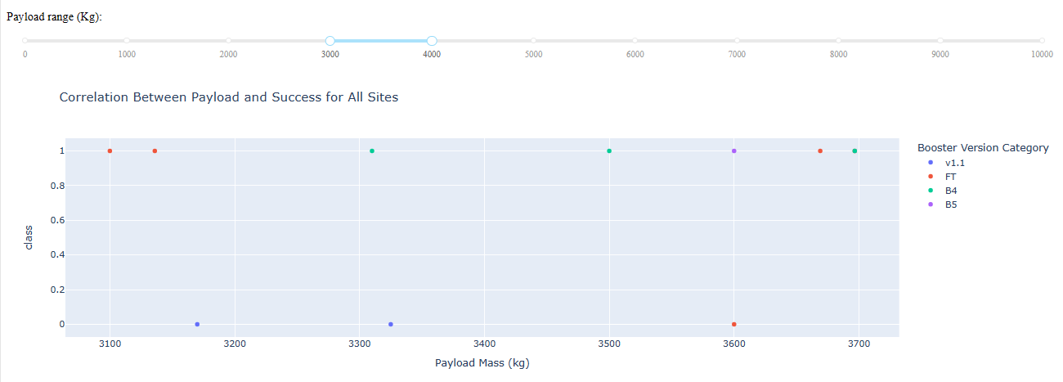
Payload range has the highest launch success rate
Q. Which payload range(s) has the highest launch success rate?
Ans-Payload Range between 3000-4000 (kg) has the highest launch success rate with 7 successful launch.

Slide 37
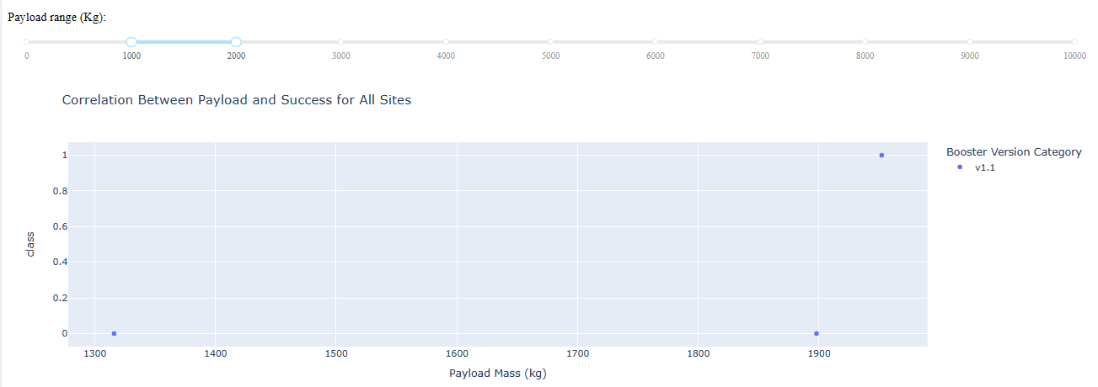
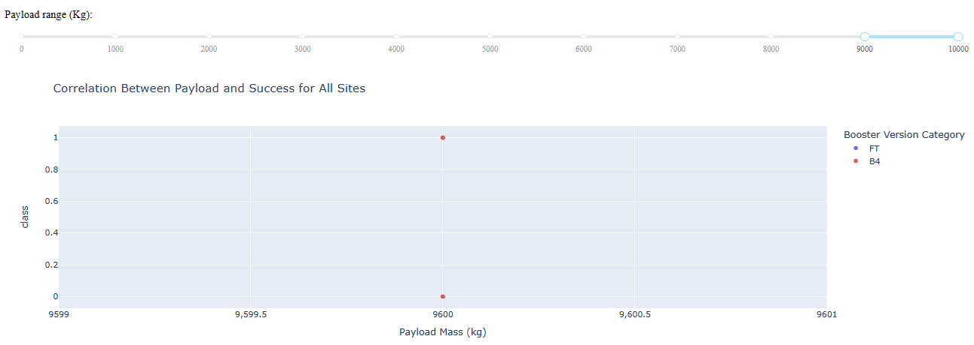
Payload range(s) has the lowest launch success rate
Q. Which payload range(s) has the lowest launch success rate?
Ans-Payload Range between 6000-9000 (kg) has no successful launch. Payload Range between 1000-2000 (kg) and 9000-10000 (kg) has only 1 successful launch.

Slide 38
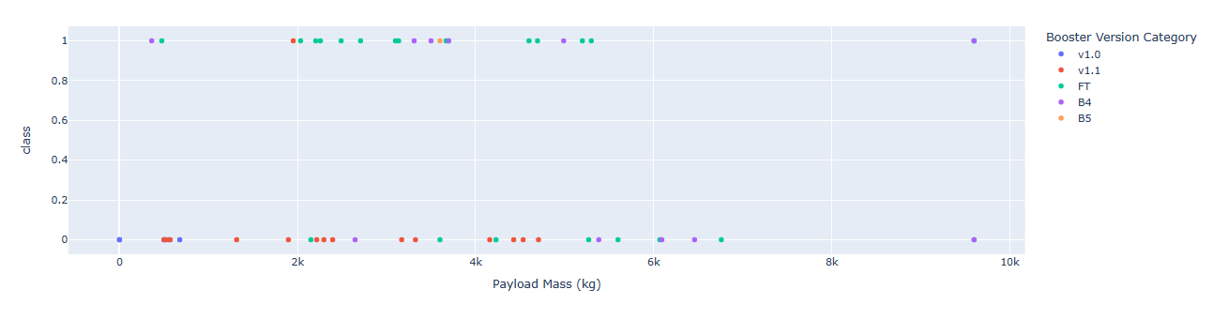
F9 Booster version (v1.0,v1.1,FT,B4,B5, etc.) has the highest launch success rate
Q. Which F9 Booster version (v1.0,v1.1,FT,B4,B5, etc.) has the highest launch success rate?
Ans-F9 Booster version (FT) has the highest launch success rate.

Slide 39
Exploratory Data Analysis
Using SQL

Slide 40
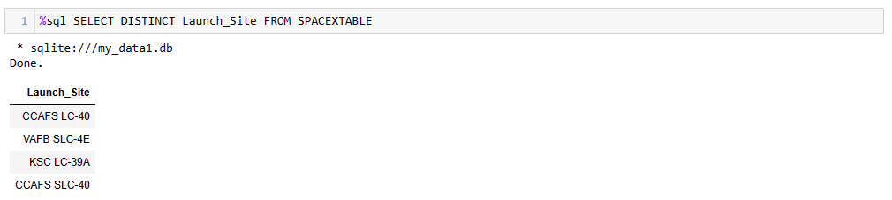
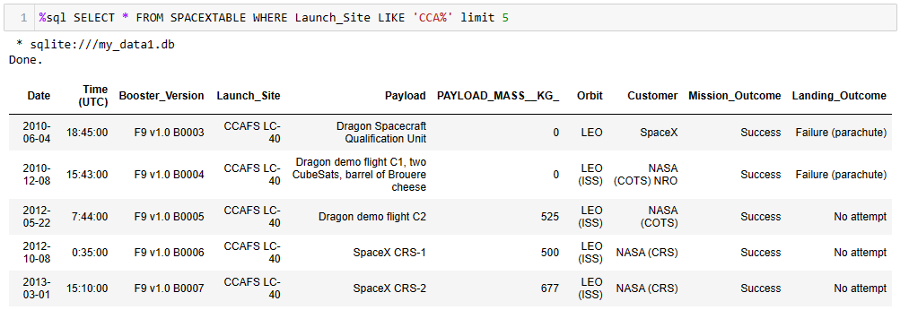
Q1. Display the names of the unique launch sites in the space mission
Q2. Display 5 records where launch sites begin with the string 'CCA'

Slide 41
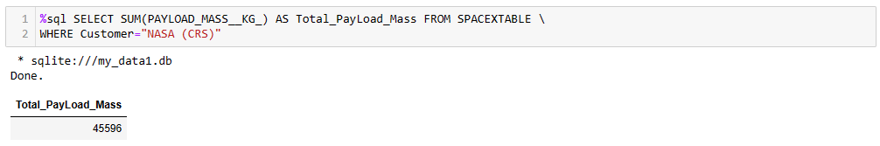
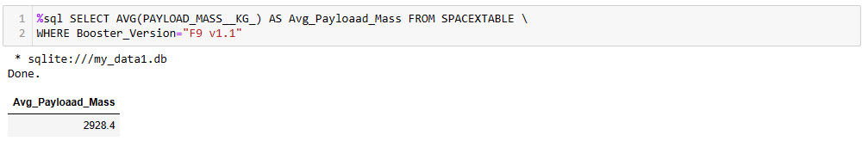
Q3. Display the total payload mass carried by boosters launched by NASA (CRS)
Q4. Display average payload mass carried by booster version F9 v1.1¶

Slide 42
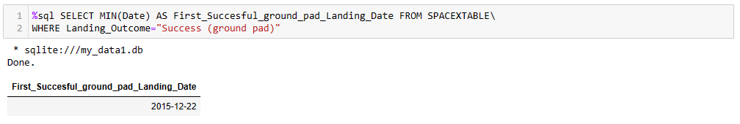
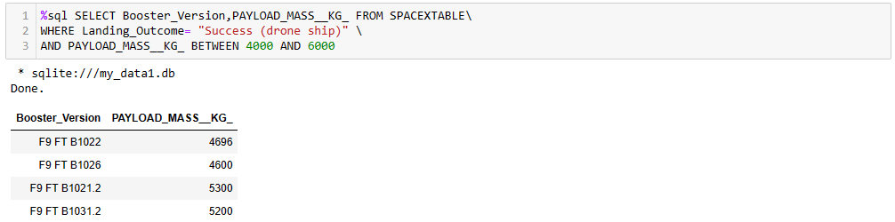
Q5. List the date when the first succesful landing outcome in ground pad was acheived.
Q6. List the names of the boosters which have success in drone ship and have payload mass greater than 4000 but less than 6000.

Slide 43
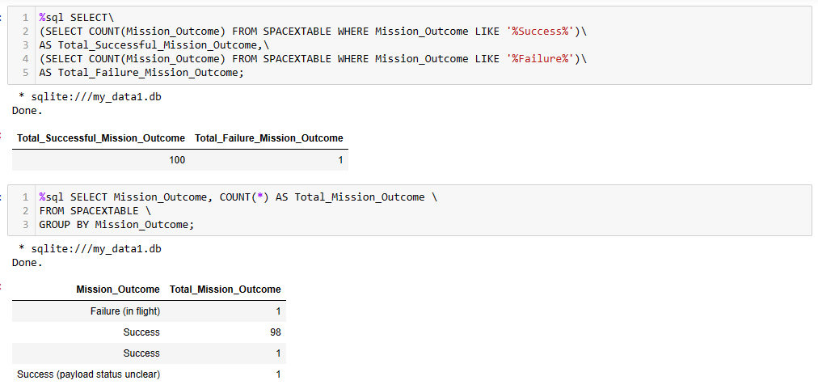
Q7. List the total number of successful and failure mission outcomes

Slide 44
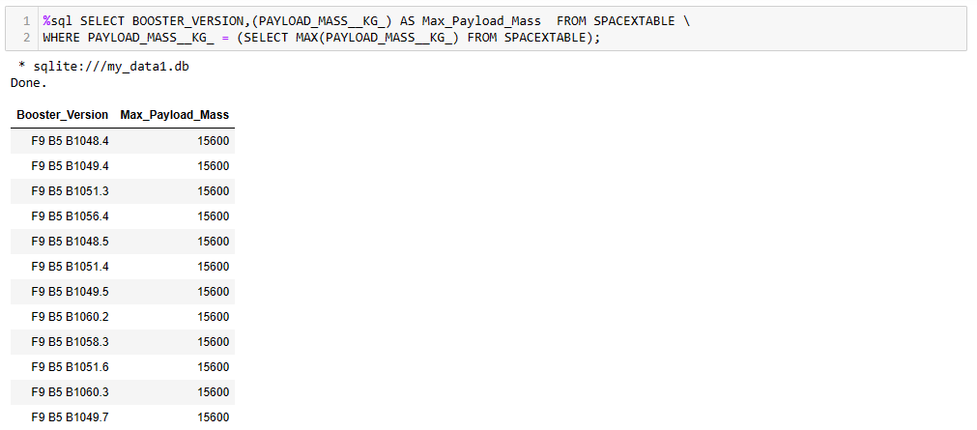
Q8. List the names of the booster_versions which have carried the maximum payload mass. Use a subquery

Slide 45
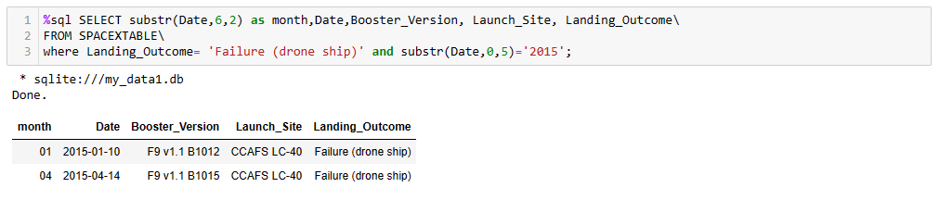
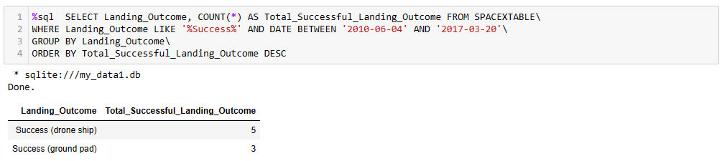
Q9. List the records which will display the month names, failure landing_outcomes in drone ship ,booster versions, launch_site for the months in year 2015.
Q10. Rank the count of landing outcomes (such as Failure (drone ship) or Success (ground pad)) between the date 2010-06-04 and 2017-03-20, in descending order.

Slide 46
Predictive Analysis

Slide 47
A machine learning pipeline is employed to predict whether the first stage will successfully land based on the provided data.
Classification algorithms, including Logistic Regression, Support Vector Machine (SVM), Decision Tree, and K Nearest Neighbour, are utilized for this prediction.
The GridSearchCV method with a cross-validation value of 10 is applied to identify the best parameters for each algorithm.
The accuracy on the validation data is assessed using the data attributes for all algorithms.
Among the algorithms, the Decision Tree algorithm exhibits slightly superior performance in terms of accuracy on the validation data.
ML Algorithm | Accuracy Score Test (%) | Accuracy (%) | Best Parameter
Decision Tree | 83.333333 | 87.678571 | {'criterion': 'entropy', 'max_depth': 18, 'max_features': 'sqrt', 'min_samples_leaf': 4, 'min_samples_split': 10, 'splitter': 'random'}

Slide 48
ML Algorithm | Accuracy Score Test (%) | Accuracy (%) | Best Parameter
Support Vector Machine | 83.333333 | 84.821429 | {'C': 1.0, 'gamma': 0.03162277660168379, 'kern...
Logistic Regression | 83.333333 | 84.642857 | {'C': 0.01, 'penalty': 'l2', 'solver': 'lbfgs'}
K Nearest Neighbour | 83.333333 | 84.821429 | {'algorithm': 'auto', 'n_neighbors': 10, 'p': 1}
Decision Tree | 83.333333 | 87.678571 | {'criterion': 'entropy', 'max_depth': 18, 'max...
The Decision Tree algorithm stands out as the best predictor among the various algorithms, demonstrating superior accuracy on the validation data.
ML Algorithm | Accuracy Score Test (%) | Accuracy (%) | Best Parameter
Decision Tree | 83.333333 | 87.678571 | {'criterion': 'entropy', 'max_depth': 18, 'max_features': 'sqrt', 'min_samples_leaf': 4, 'min_samples_split': 10, 'splitter': 'random'}

Slide 49
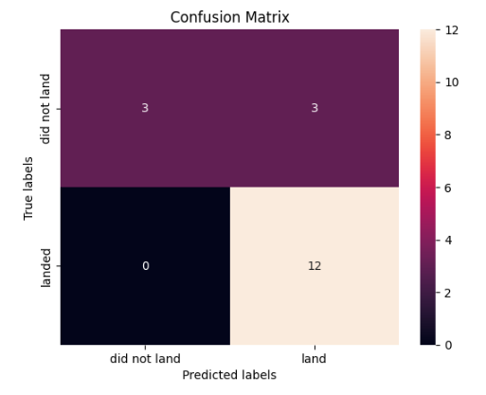
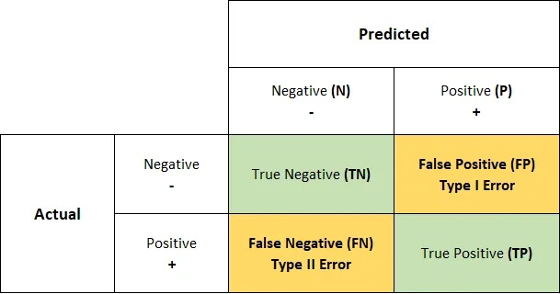
DECISION TREE CLASSIFICATION CONFUSION MATRIX
True Negative (TN) = 3 | False Positive (FP) = 3
False Negative (FN) =0 | True Positive (TP) =12
CONFUSION MATRIX OUTPUT
In a confusion matrix, a false positive (FP) occurs when the model predicts the positive class, but the actual class is negative. In other words, the model incorrectly identifies instances as positive when they are, in fact, negative. This situation is also known as a Type I error.

Slide 50
Conclusions
As the flight number increases from the launch sites, the success rate also improves. Initially, the success rate is poor.
The higher the payload, the higher the success rate.
Most payloads weighing more than 12000 kg are launched from CCAFS SLC 40 launch site.
VAFB-SLC launch site there are no rockets launched for heavy payload mass(greater than 10000).
ES-L1, GEO, HEO, and SSO have a 100% success rate.
SO has a 0% success rate.
GTO, ISS, LEO, MEO, and PO have success rates between 50% and 80%.
Space launch sites are situated near the equator to leverage the Earth's higher rotational velocity, reducing the energy required for launches. This efficiency allows rockets to carry heavier payloads and reach various orbital inclinations. Proximity to the equator also offers safety benefits by directing launch debris over open ocean areas.
Space launch sites near coasts provide clear, unpopulated paths over the ocean, minimizing risks in case of launch failures. Coastal locations aid logistical efficiency by allowing transport of rockets and components by sea.
The Decision Tree algorithm stands out as the best predictor among the various algorithms, demonstrating superior accuracy on the validation data.

Slide 51
Insights
Launch Site: Choose equatorial sites for efficient launches and heavier payloads. Opt for coastal locations to ensure safety and streamline logistics.
Payload Optimization: Focus on higher payloads for better success rates. CCAFS SLC 40 is suitable for payloads >12000 kg; avoid VAFB-SLC for payloads >10000 kg.
Orbital Success: Target high success rate orbits like ES-L1, GEO, HEO, and SSO (100% success). Avoid SO orbit with 0% success.
Algorithmic Prediction: Use Decision Tree algorithm for accurate predictive modeling, considering factors like launch site, payload weight, and orbital destination.
Risk Mitigation: Manage risks for orbits like GTO, ISS, LEO, MEO, and PO (50-80% success) with robust strategies, including redundancy, thorough testing, and continuous improvement.
Logistics Efficiency: Optimize logistics with coastal launch sites, facilitating sea transport for rockets and components, enhancing operational efficiency, and minimizing risks in populated areas.

Slide 52
Project Files Links
CONTENT | FILE LINKS
Project Repository | GitHub Repository Link
Data Collection API | Data collection from API file link
Data Collection Web Scrapping | Web Scrapping file link
Data Wrangling | Data Wrangling File Link
Exploratory Data Analysis – SQL | SQL FILE LINK
Exploratory Data Analysis – Visualization | EDA Visualization File Link
Visual Analytics with Folium | Interactive Map with Folium File Link
Interactive Space X Dashboard - Dash | Interactive Dashboard with plotly dash file link
Predictive Analysis – Machine Learning | Predictive analysis (Machine Learning) File Link

